Slide 1
Frequently Asked Questions about Work-Based Learning Guidelines for Youth February 3rd, 2022

Slide 2
Housekeeping:
Closed Captioning is available at https://www.streamtext.net/player?event=ASLIS-COSG-KY
If you have any questions, please submit them through the chat feature
If you have technical difficulties, please use the Chat feature to type a question and CSG staff will get back to you as soon as possible

Slide 3
Opening Remarks
Jennifer Kemp
Director, Division of Youth Services, Employment and Training Administration (ETA)

Slide 4
Bringing it all together
Frequently Asked Questions (FAQs) to help employers, educators, youth service providers, and youth/families understand laws and regulations when engaging youth in a work-based learning (WBL) /work experience activities
Frequently Asked Questions (FAQ's) about Work-Based Learning Guidelines for Youth https://d2leuf3vilid4d.cloudfront.net/-/media/0F5522C7F78145B0A935FE893D2066EB.ashx?rev=C9EE7671E244645F77B5291A62DF20AD
Federal, State, and Non-Profit Resources for Work-Based Learning (WBL) Activities https://d2leuf3vilid4d.cloudfront.net/-/media/42CB360F3CFF4636B13E5C12FFFFEEC8.ashx?rev=937B2C3769DC504201BC76B057A0B3ED

Slide 5
Setting the Stage
Jim Means
Education Program Specialist, Office of Career and Technical Education (OCTAE), College and Career Transitions Branch

Slide 6
WBL Resources
Perkins Collaborative Resource Network (PCRN), https://cte.ed.gov/
Work-Based Learning Information, https://cte.ed.gov/initiatives/work-based-learning
Summary of Responses to the US Dept. of Education’s RIF on WBL,
https://s3.amazonaws.com/PCRN/file/WBL-RFI-Comments-Summary.pdf
Work-Based Learning Tool Kit, https://cte.ed.gov/wbltoolkit/
The tool kit includes activities, featured resources, and state examples for creating a WBL strategy, engaging employers, data collection, scaling programs, and background information.

Slide 7
Poll Question

Slide 8
Workplace Guidelines: Laws and Regulations for Work Based Learning (WBL)
Programs

Slide 9
Wage and Hour Division (WHD)
Randolph Tan
Community Outreach and Resource Planning Specialist

Slide 10
Essential Workers Essential Protections

Slide 11
Wage and Hour Division
Who we are

Slide 12
Enforcing Workplace Protections
10 million establishments nationwide and 148 million workers covered.
More than 200 WHD offices throughout the country.
More than 200 languages spoken.

Slide 13
Wage and Hour Division (1 of 2)
Every state has laws specifically dealing with child labor issues.
When federal and state standards are different, rules that provide the most protection to youth workers apply.
Employers must comply with both federal laws and applicable state laws.

Slide 14
Wage and Hour Division (2 of 2)
What we do

Slide 15
Achieving Compliance
Investigations
Outreach to workers
Education for employers
Partnerships

Slide 16
Essential Protections
Under the Fair Labor Standards Act

Slide 17
Child Labor (1 of 2)
In non-agricultural jobs…
Minimum age of employment is 14
Hours and occupations are restricted for 14- and 15-year-olds
Hazardous occupations are prohibited for every covered worker under 18 years of age
Some exceptions for minors working for their parents

Slide 18
Child Labor (2 of 2)
Hours Restrictions in non-agricultural jobs…
Apply to 14- and 15-year-olds only
Not during school hours
No more than 3 hours on a school day or 8 hours on a non-school day
No more than 18 hours during school weeks or 40 hours during non-school weeks
Not before 7 a.m. and not after 7 p.m. except from June 1 to Labor Day when the time is extended until 9 p.m.

Slide 19
Contact WHD
Visit www.dol.gov/agencies/whd
Call our toll-free information and helpline at 1-866-4US-WAGE (1-866-487-9243)

Slide 20
Disclaimer
This presentation is intended as general information only and does not carry the force of legal opinion.
The Department of Labor is providing this information as a public service. This information and related materials are presented to give the public access to information on Department of Labor programs. You should be aware that, while we try to keep the information timely and accurate, there will often be a delay between official publications of the materials and the modification of these pages. Therefore, we make no express or implied guarantees. The Federal Register and the Code of Federal Regulations remain the official source for regulatory information published by the Department of Labor. We will make every effort to keep this information current and to correct errors brought to our attention.

Slide 21
Occupational Safety and Health Administration (OSHA) – 1 of 2
Shaharazade Thompkins-Lewis
National Alliance Coordinator

Slide 22
Occupational Safety and Health Administration (OSHA) – 2 of 2
Christina Jones
Director, Office of Outreach Services and Alliances

Slide 23
Protecting Young Workers Guidelines and Resources for a Safe and Healthful Workplace
By: Shaharazade Thompkins-Lewis, MPA
National Alliance Coordinator
U.S. Department of Labor
Occupational Safety and Health Administration

Slide 24
Protecting Young Workers
Workers of all ages have rights to safe workplaces:
to raise concerns about hazards without fear of retaliation
to receive training and PPE
to ask questions if something seems unsafe
www.osha.gov/youngworkers
OSHA: Young Workers’ Rights (Spanish)
OSHA: Young Workers’ Rights (English)

Slide 25
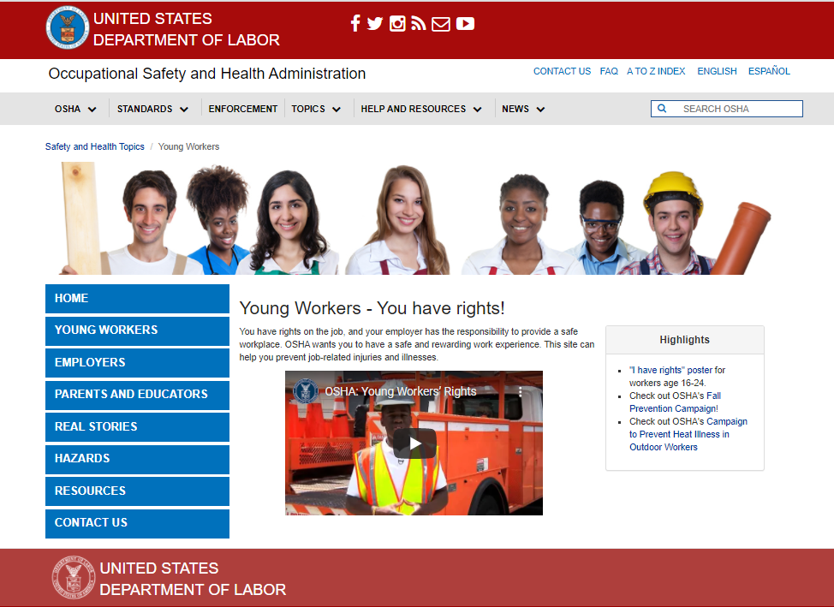
Resources: Young Workers https://www.osha.gov/young-workers

Slide 26
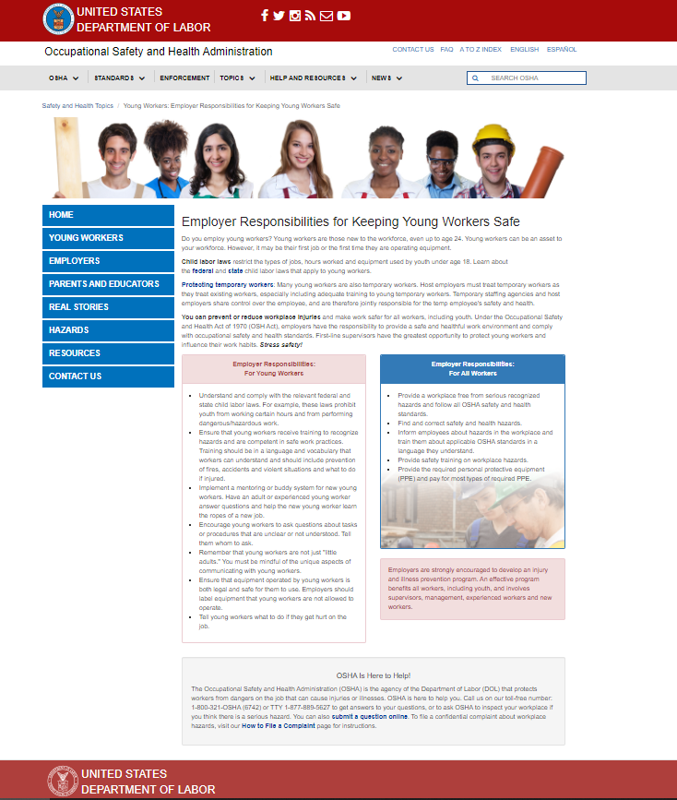
Resources: Young Workers (1 of 2) https://www.osha.gov/young-workers

Slide 27
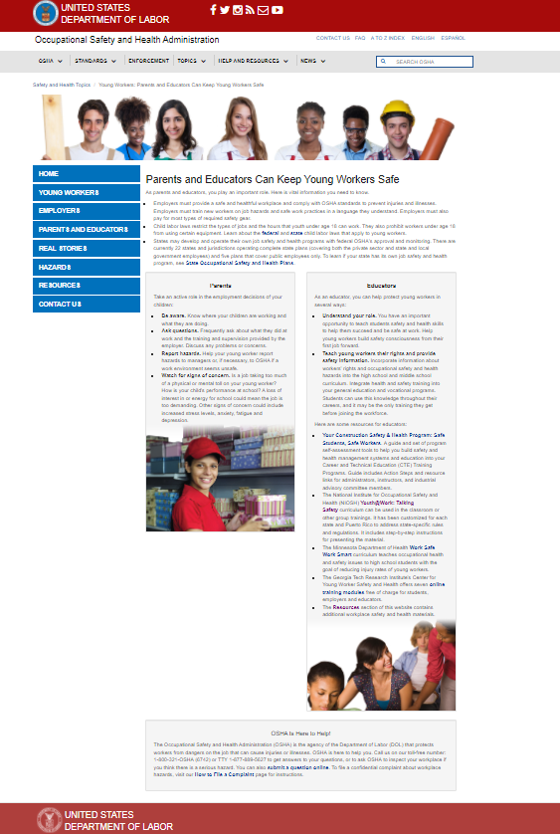
Resources: Young Workers (2 of 2) https://www.osha.gov/young-workers

Slide 28
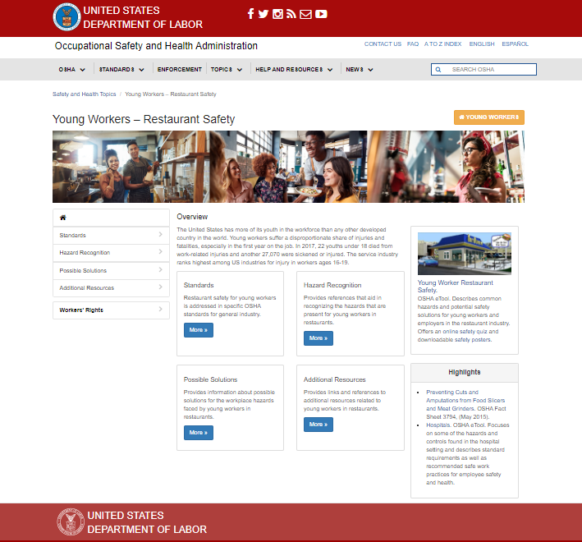
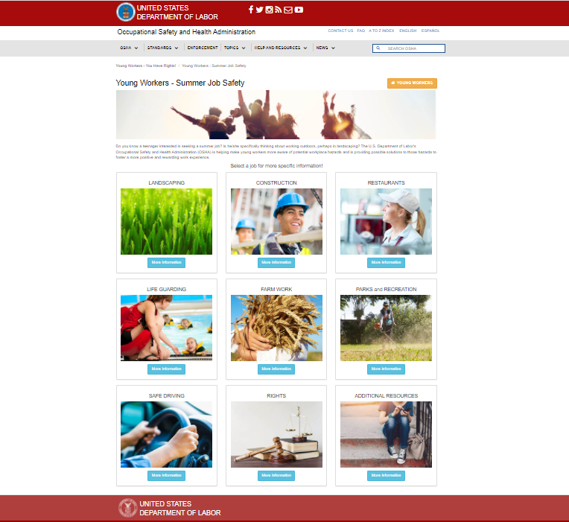
Resources: Summer Job Safety https://www.osha.gov/SLTC/youth/summerjobs/index.html

Slide 29
Resources: Safety & Health Programs https://www.osha.gov/safety-management

Slide 30
Youth@Work: Talking Safety https://www.cdc.gov/niosh/talkingsafety
Curriculum created by NIOSH
Tool for educators to use in classrooms or group trainings
Covers state-specific regulations

Slide 31
#KeepTeenWorkersSafe https://www.keepteenworkerssafe.org
The Teen Worker Social Media Campaign aimed to:
Increase awareness about workplace safety and health
Promote workplace safety and health resources for teen workers

Slide 32
Thank You!

Slide 33
Examples of State and Non-Profit Resources for WBL Program Providers

Slide 34
Office of Disability Employment Policy (ODEP)
Kirk Lew
Director of Youth Initiatives

Slide 35
ODEP
Part of U.S. Department of Labor
Non-regulatory
Promotes policies and coordinates with employers and all levels of government to increase workplace success for people with disabilities
Mission: To develop and influence policies that increase the number and quality of employment opportunities for people with disabilities
dol.gov/odep

Slide 36
Intro to CAPE-Youth
The Center for Advancing Policy on Employment for Youth (CAPE-Youth) seeks to improve employment outcomes for youth and young adults with disabilities by helping states build capacity in their youth service delivery and workforce systems.

Slide 37
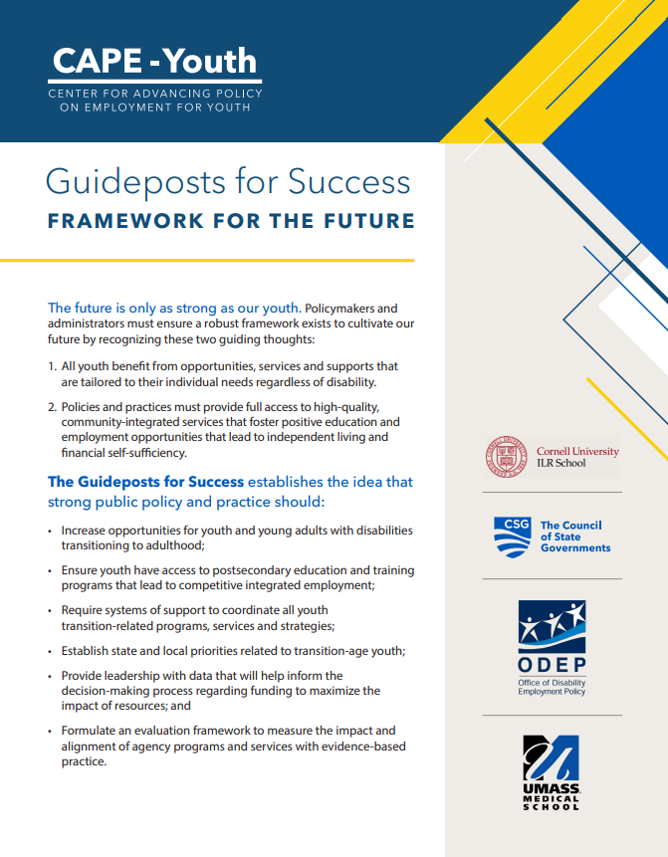
Guideposts for Success:​ Framework for the Future
What are the Guideposts for Success?​
School-Based Preparatory Experiences; ​
Career Preparation and Work-Based Learning Experiences; ​
Youth Development and Leadership;
Connecting Activities; and ​
Family Involvement and Supports.
Read the Guideposts here: https://capeyouth.org/resources/
Watch our Guideposts to Success Webinar here: https://seed.csg.org/ada30/

Slide 38
State Scans
State-by-state scans of programs, policies, resources, and initiatives that support Y&YAD in their transitions
COVID-19 Scan
Program Scan
Policy Scan
Help users identify promising practices and opportunities for collaboration

Slide 39
Q&A

Slide 40
Contact Us
Jennifer Kemp, ETA, Kemp.Jennifer.N@dol.gov
Jim Means, OCTAE, James.Means@ed.gov
Randolph Tan, WHD, Tan.Randolph@dol.gov
Shaharazade Thompkins-Lewis, OSHA, Thompkins-Lewis.Shaharazade@dol.gov
Tina Jones, OSHA, Jones.Tina@dol.gov
Kirk Lew, ODEP, Lew.Kirk.A@dol.gov

