Slide 1
November 15, 2022 4-5pm EST
Apprenticeship Intermediary Webinar

Slide 2
Housekeeping
Closed Captioning is available
Please submit any questions (including about technical issues) in the chat and The Council of State Government (CSG) staff will get back to you as soon as possible

Slide 3
Welcome
Sydney Blodgett
Program Manager, The Council of State Governments

Slide 4
Introduction to CAPE-Youth
The Center for Advancing Policy on Employment for Youth (CAPE-Youth) seeks to improve employment outcomes for youth and young adults with disabilities by helping states build capacity in their youth service delivery and workforce systems.

Slide 5
Partners
CAPE-Youth is a collaboration between the U.S. Department of Labor’s Office of Disability Employment Policy and:
The center is fully funded by the United States Department of Labor’s Office of Disability Employment Policy in the amount of $5 million under Cooperative Agreement No. OD-33982-19-75-4-21
Notes:
CAPE-Youth is a collaboration between:
The Department of Labor’s Office of Disability Employment Policy.
The Council of State Governments;
The K. Lisa Yang and Hock E. Tan Institute on Employment and Disability at Cornell University; and
The center is fully funded by the United States Department of Labor’s Office of Disability Employment Policy in the amount of $5 million under Cooperative Agreement No. OD-33982-19-75-4-21

Slide 6
What are apprenticeships?
Apprenticeship is an industry-driven, high-quality career pathway where individuals can obtain paid work experience, classroom instruction, and a portable credential.
Notes:
An apprenticeship program is an employer-driven program providing individuals with a combination of on-the-job training and virtual or in-person related instruction that supports on-the-job learning.[5] Training and instruction are focused on helping the apprentice master skills needed to succeed in a specific occupation. Apprentices are paid while they learn and gain credentials to support their long-term success in the workplace. Historically, apprenticeship programs were in trades such as electrical or construction industries; however, there is growing interest in apprenticeships within non-traditional fields such as health care, energy and information technology (IT). Apprenticeships are a viable career pathway leading to high-paying jobs and providing a portable credential upon completion.[6]
Research indicates apprenticeship is a promising model leading to positive employment outcomes for Y&YADs.[8] States can utilize apprenticeships to build a more diverse and skilled workforce, meet specific labor market needs, increase the tax base and grow state economies. Moreover, states can benefit greatly from promoting apprenticeships that are inclusive and accessible. Inclusive apprenticeship programs are designed to be accessible to and inclusive of all participants, including people with disabilities. By promoting inclusive apprenticeships for Y&YADs, state workforce systems can make apprenticeship programs and opportunities accessible to the over 1.3 million young people with a disability between the ages of 16 and 24 who might otherwise struggle to find a pathway to employment. Inclusive apprenticeship programs widen the talent pool and provide opportunities for people with disabilities (including individuals with cognitive, neurological, physical, mental health and sensory disabilities) to gain credentials and skills to succeed in their desired careers.[9]

Slide 7
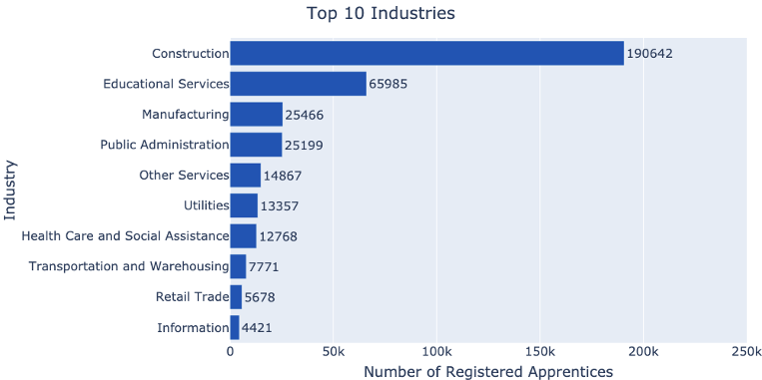
Statistics
Most Common Apprenticeships
Graphic from apprenticeship. gov
Analysis completed by ADAP-TAC utilizing DOL RAPIDS Data.

Slide 8
Emerging Apprenticeship Industries
Graphic from apprenticeship. gov

Slide 9
Apprenticeship Facts
Graphic from apprenticeship. gov

Slide 10
The Benefits of Apprenticeship
For the Apprentice​ | For the Employer​ | For the State​
Little or no educational debt​ | A pipeline of qualified workers​ | Developing private sector partners​
Hands on training​ | Tailored training​ | Post-COVID workforce recovery​
Potential for college credit​ with little or no debt | Increased knowledge transfer​ | Pipeline of qualified public and private employees​
Career development​ | Employee retention​ | Reducing unemployment​
Certified portable credentials​ | High quality standards​ | Custom training and reduced onboarding costs​
$72K Average starting salary​ | Tax credits​ | Creating a model for others to follow​

Slide 11
Inclusive Apprenticeship
Equal opportunity is promoted for apprentices and applicants in RAP by prohibiting discrimination based on race, color, religion, national origin, sex, sexual orientation, age, genetic information, and disability.
Apprenticeship sponsors are required to provide reasonable accommodations, upon request, to applicants and apprentices with disabilities to allow them to perform critical job functions. Examples include:
physical accessibility of facilities;
flexible work schedules;
new or modified tools;
and equipment and personnel support as needed.

Slide 12
Policy Considerations
State strategies for fostering inclusive apprenticeships include:
Utilizing incentives;
Encouraging collaboration;
Using data-based decision making to improve enrollment and retention;
Providing wraparound services and support; and
Acting as a model employer.

Slide 13
Panel Discussion
John Marotta, Senior Policy Associate Urban Institute
Vanessa Bennett, Associate Director
Jobs for the Future

Slide 14
Contact CAPE-Youth
Questions?
Contact Us
CAPEYouth.org
info@capeyouth.org
sblodgett@csg.org

