Slide 1
State Policies to Improve Mental Health and Employment for Youth with Marginalized Racial Identities
1

Slide 2
Housekeeping
Closed captioning is available through Zoom. Access can be found under the settings tab on your Zoom toolbar.
Please submit any questions (including technical issues) in the Q&A feature at the bottom of the Zoom window. Staff will respond as soon as possible.
2

Slide 3
The Center for Advancing Policy on Employment
for Youth​
The Center for Advancing Policy on Employment for Youth (CAPE-Youth) seeks to improve employment outcomes for youth and young adults with disabilities (Y&YADs) by helping states build capacity in their youth service delivery and workforce systems.

Slide 4
CAPE-Youth Partners
The center is fully funded by the U.S. Department of Labor Office of Disability Employment Policy (ODEP) in the amount of $7.5 million under Cooperative Agreement No. 23475OD000001-01-00.
4

Slide 5
CAPE-Youth Strands of Work
CAPE-Youth:
Researches new and existing innovative policy and practice.
Develops strategic partnerships.
Shares best practices among key stakeholders.
Helps states identify opportunities for new programs and services.
5

Slide 6
Opening Remarks
Rachel Patterson
Director of Disability Policy
White House Domestic Policy Council
6

Slide 7
Overview and Policy Considerations for Youth with Marginalized Racial Identities​
Adene Karhan
Extension Associate
Yang-Tan Institute on Employment and Disability – Cornell University

Slide 8
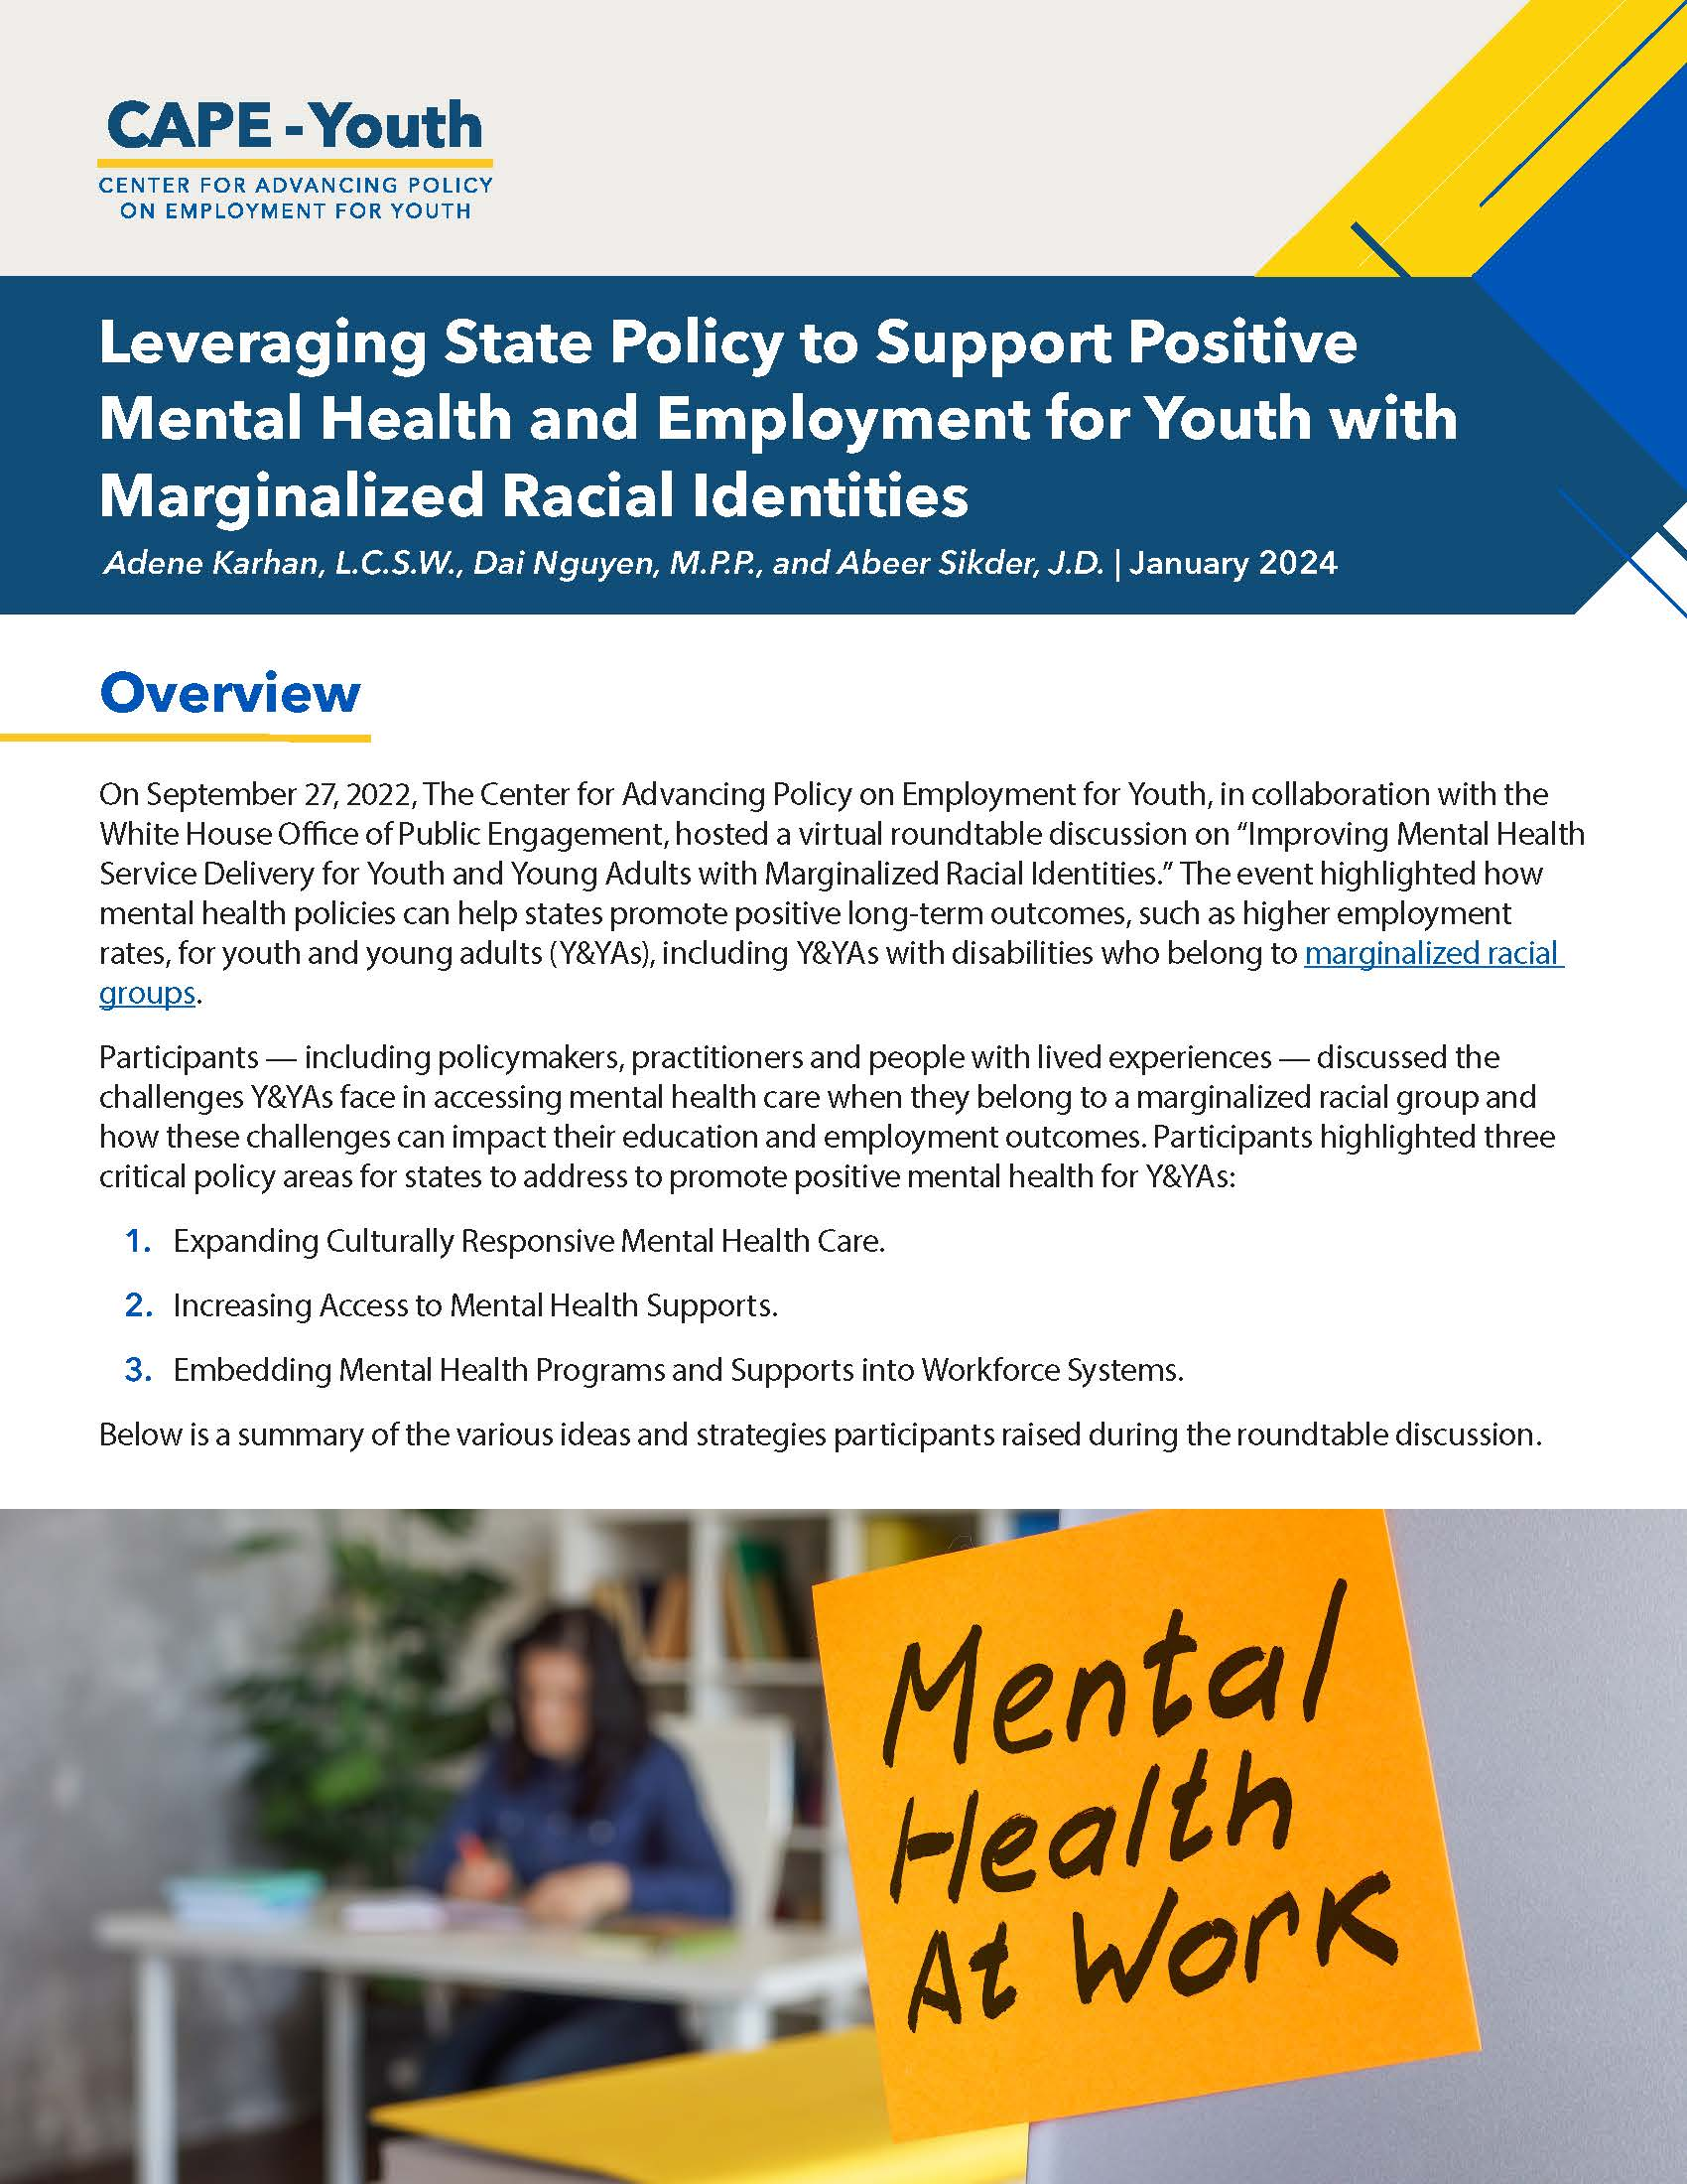
Policy Brief
Leveraging State Policy to Support Positive Mental Health and Employment for Youth with Marginalized Racial Identities
Notes:
On September 27, 2022, The Center for Advancing Policy on Employment for Youth, in collaboration with the White House Office of Public Engagement, hosted a virtual roundtable discussion on “Improving Mental Health Service Delivery for Youth and Young Adults with Marginalized Racial Identities.”
The event highlighted how mental health policies can help states promote positive long-term outcomes, such as higher employment rates, for youth and young adults (Y&YAs), including Y&YAs with disabilities who belong to marginalized racial groups.
Participants — included policymakers, practitioners and people with lived experiences — discussed the challenges Y&YAs face in accessing mental health care when they belong to a marginalized racial group and how these challenges can impact their education and employment outcomes. Participants highlighted three critical policy areas for states to address to promote positive mental health for Y&YAs

Slide 9
Policy Considerations
1
Expand culturally responsive mental health
care.
2
Increase access to mental health supports.
3
Embed mental health programs and supports into workforce systems.
Notes:
The mental health brief outlines several overarching policy considerations to help address the current mental health needs of youth and young adults.
1. The first policy consideration is focused on expanding Cultural responsiveness within mental health care for youth and young adults (and in a few minutes you are going to hear about some innovative ways that Montana is expanding on culturally responsive practices within their state).
•Cultural responsiveness is a practice which encourages mental health professionals and the systems they operate in to create individualized and holistic mental health care plans incorporating multiple factors influencing individual experiences.
•By being sensitive to the cultural considerations of marginalized populations, professionals can gain a more complete and accurate assessment of the person’s needs and better align treatment recommendations with personal values.
2. The second policy consideration outlined in the brief involves increasing access to mental health supports for youth and young adults as a means of removing barriers to employment and postsecondary education. There are many youth and young adults who would benefit from mental health supports who do not have access to them due to lack of insurance or transportation, historical trauma and difficulty establishing trust with service providers, stigma surrounding mental health, and a variety of other factors. On today's panel you will hear about some exciting initiatives within the state of Hawaii to help connect more youth young adults to mental health services and supports.
The third policy recommendation focuses on embedding mental health programs and supports into workforce systems.
Rates of depression and anxiety among youth and young adults have reached a point of national crisis, and when individuals are not connected with supports to manage their mental health symptoms, it makes it difficult to stay connected to school and work. Yet, this connection to community and meaningful work is one of the best buffers against depression and anxiety. Many individuals with mental health conditions want to engage in meaningful work, but feel like they are forced to choose between maintaining their mental health and working. You will hear from the final speaker today about some innovative practices the state of NY is using to support the holistic needs of youth and young adults as they start out on their career path.

Slide 10
Current State of Youth Mental Health
Our country is experiencing a youth mental health crisis, including alarming increases in youth suicide in recent years.
Youth and young adults (Y&YAs) exposed to racism, discrimination, and other adverse experiences are disproportionately impacted by mental health conditions.
They also frequently experience reduced access to high-quality, evidence-based mental health services and receive fewer follow-ups in a variety of provider settings.
National Institute of Mental Health – Strategic Framework for Addressing Youth Mental Health Disparities​
Notes:
Adene will add a recent statistic around Y&YA mental health rates

Slide 11
Connection Between Experiencing Discrimination and Mental Health
Experiencing racial trauma and discrimination can lead to the chronic release of stress hormones, which increases the risk of youth developing mental health conditions such as anxiety and depression.
While the prevalence of mental health conditions is similar among the white population and other racial and ethnic populations, the long-term impact of mental health conditions on racial and ethnic minorities is higher (e.g., greater impact on employment).
Mental Health America – Racism and Mental Health
Mental Health America – The State of Mental Health in America 2023 Report
Mental Health America – Racism and Mental Health
Notes:
Adene will expand on the 2nd bullet with some additional information from the resource cited here

Slide 12
CAPE-Youth Resources
Policy Briefs:
Improving Mental Health Service Delivery Including Coordinated Specialty Care for Youth with a First Episode of Psychosis
Trauma-Informed Policy for Youth
Addressing the Needs of Youth with Disabilities and Other Intersecting Identities: State Strategies for Program Design
Addressing the Needs of Youth with Disabilities and Other Intersecting Identities: State Strategies for Program Implementation
Contact Adene Karhan at ak839@cornell.edu if you have any questions.
Notes:
Here we have some names and links to policy briefs from CAPE-Youth that touch upon mental health, disability, and race, and overlapping topics as well, including trauma.
Adene passes back to Abeer

Slide 13
Hawaii: Community and School-based Mental Health Supports
Annie Kalama
Assistant Superintendent – Office of Student Support Services
Hawaii State Department of Education

Slide 14
Access to Mental Health
in Hawaii Schools
HAWAI‘I STATE
Department of Education
Annie Kalama
Assistant Superintendent, Office of Student Support Services

Slide 15
Hawaii’s Public Schools
295
PUBLIC SCHOOLS
42,370 EMPLOYEES
167,649 STUDENTS
STUDENT CHARACTERISTICS *Economically Disadvantaged: 55% *Special Education: 10% *English Learners: 9% More than 1 high need (*): 13% | Military Impacted: 6% Experiencing Homelessness: 2% Foster Youth: 1% Migrant: 1%
15

Slide 16
2023-2029 Strategic Plan
16
High Leverage Priorities
Workforce Readiness | Middle School
Math Innovation | Vulnerable Populations
K-12 Alignment | Teacher Recruitment
Leadership Development | Facilities
16

Slide 17
State of Hawaii
Office of Wellness and Resiliency
Governors Executive Order - Trauma Informed State
Legislative Support
On February 20, Governor Josh Green, M.D., signed an executive order declaring Hawai‘i a trauma-informed state. Photo courtesy of Office of the Governor.
17

Slide 18
Systems of Support
Na Hopena A’o
Hawaii Multi-Tiered System of Support (HMTSS)
School Based Behavioral Health Program
18

Slide 19
19

Slide 20
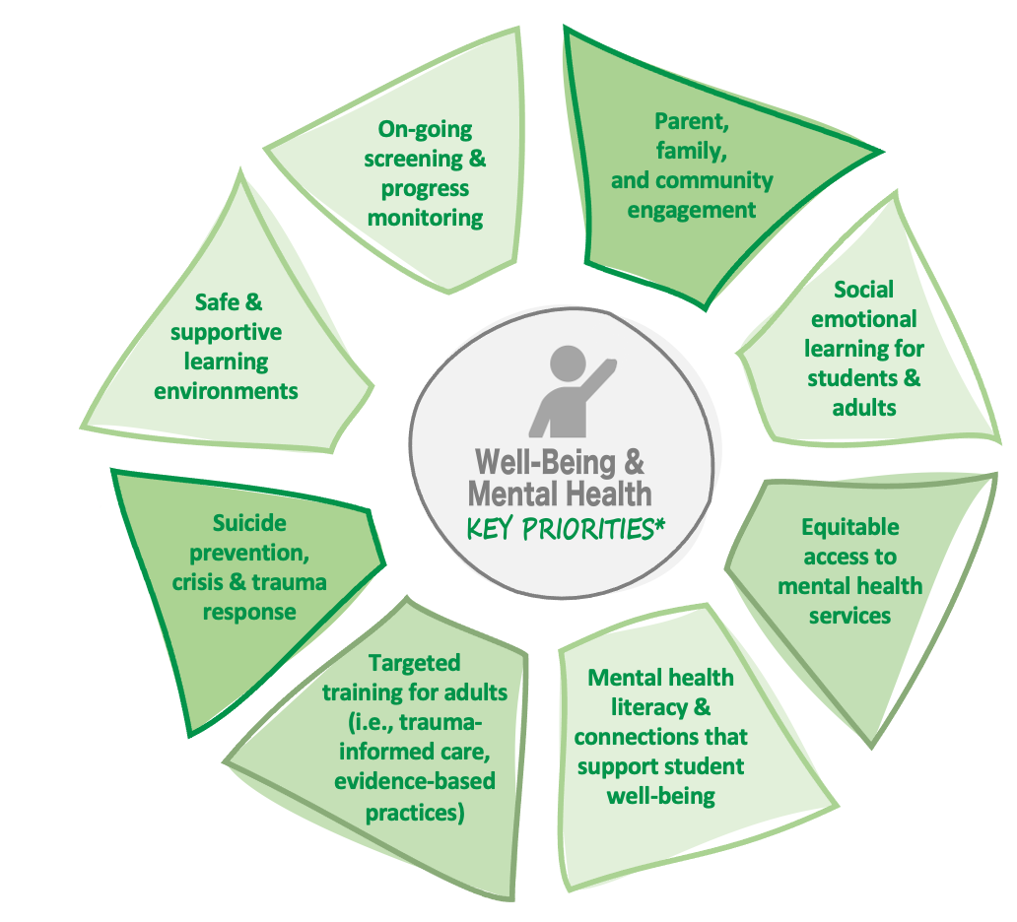
20

Slide 21
21
Equitable access
Immediately scalable across entire state
Ability to serve all students
Care regardless of insurance, immigration, or language
Comprehensive services
Preventative & acute mental health supports
Alignment with tiered interventions
Support of the MTSS Process
Support in building a local wellness ecosystem
Network for community-based support

Slide 22
References
Hawaii DOE Strategic Plan
https://www.hawaiipublicschools.org/VisionForSuccess/AdvancingEducation/StrategicPlan/Pages/home.aspx
Hawaii DOE Here to HELP
https://www.hawaiipublicschools.org/ParentsAndStudents/SupportForStudents/StudentWell-being/Pages/default.aspx
Governor’s Office of Wellness and Resiliency
https://governor.hawaii.gov/office-of-wellness-and-resilience/
22

Slide 23
Globally Competitive. Locally Committed.
23
HawaiiPublicSchools.org

Slide 24
New York: Workforce Supports for Youth Mental Health
Robert Lettieri
Long Island Regional Youth Advocacy Specialist
New York State Office of Mental Health

Slide 25
Strategies to Improve Youth Mental Health and Employment
Robert Lettieri
New York State Office of Mental Health

Slide 26
Agenda
Personal lived experience.
Social determinants of health.
Youth peer support.
What can be done?
New York State (NYS) initiatives.
Peer certifications/credentials in NYS.

Slide 27
Lived Experience
Tourette’s Syndrome.
Seizure Disorder.
Medically induced comas.
Failing treatments.
Deep brain stimulation.
Emotional distress.
Systems navigation.
Systemic barriers.
Advocacy, training, and college.

Slide 28
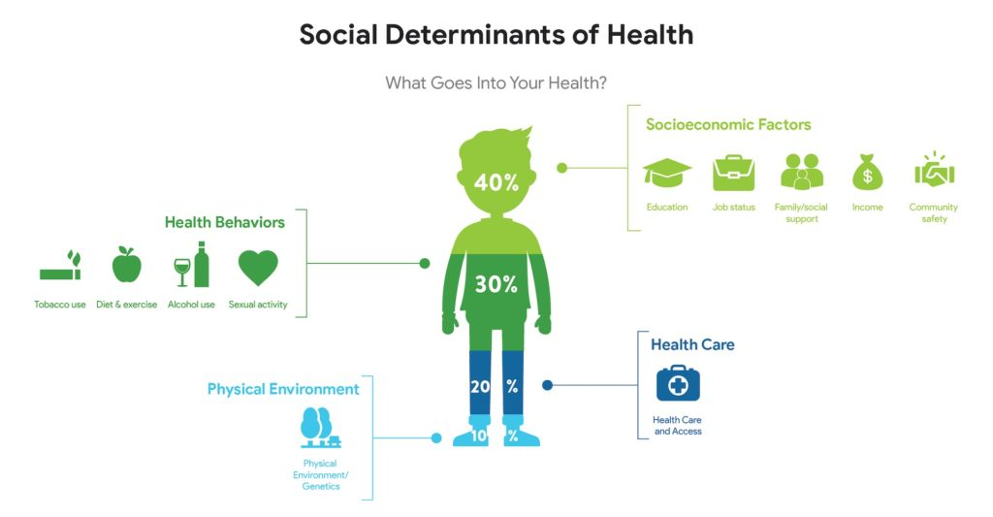
Addressing the Social Determinants of Health
Economic Stability.
Education Access and Quality.
Health Care Access and Quality.
Neighborhood and Built Environment.
Social and Community Context.

Slide 29
Introduction To the Peer Community
Feeling of liberation meeting individuals who experienced adverse life experiences and were offering support to others while advocating for positive social change.
Healing Connections Peer Support Group.
Careers in Recovery and Wellness Training.
University Youth Power (UYP).

Slide 30
Youth Peer Support
Youth Peer Support aims to provide youth and young adults opportunities to gain emotional support, information, skills, and connection to resources, and foster trusting and supportive relationships with people of their own generation who recently experienced similar challenges.

Slide 31
What is a Youth Peer Advocate?
Youth Peer Advocates (YPAs) are individuals:
between 18-30 years old.
who self-identify as a person with lived experience with a social, emotional, medical, developmental, substance use, and/or behavioral challenges as a young person or has received services in any one of the child-serving systems (juvenile justice, foster care, special education or addiction recovery).
YPAs use their lived experience to promote resiliency, recovery, wellness, and self-efficacy in young people and promote the practice of youth-guided and family-driven approaches.

Slide 32
Benefits of Peer Support
Improved quality of life for service recipients.
Increased service engagement and satisfaction with services and supports.
Improved well being.
Individuals realize they are not alone.
Individuals can express themselves without fearing judgement or retaliation.
Individuals gain hope.
Peer supporters find a purpose.
Peers are approachable.
Decreased hospitalization rates.
Reduction in overall cost of services.

Slide 33
What can be done?
Increase mental health education in schools.
Expand access to youth peer support services.
Community integrated mental health supports.
Expand access to support services that do not require insurance.
Incentivize mental health and peer workforce.
Promote youth inclusion and leadership.

Slide 34
New York State Initiatives
SUNY Empire State University awards 12 credits to the YPA Credential.
Youth-led wellness education programs.
Cross Credentialing between YPA and NYCPS.
Intensive and Sustained Engagement Teams (INSET).
Governor Kathy Hochul’s Youth Roundtable Listening Tour 2023.
Youth Advisory Board with Governor Kathy Hochul’s Executive Committee.
Imbedding youth and family voice & presence within programs.
Ex: Youth ACT, Young Adult ACT, and other programs/initiatives.
School based mental health grants.
More than 1,200 school based mental health clinics.

Slide 35
Peer Certifications in NYS
Youth Peer Advocate Credential (YPA-C).
https://www.ftnys.org/yp-ypa-credential/
Family Peer Advocate Credential (FPA-C).
https://www.ftnys.org/workforce/family-peer-advocate-credential/
New York Certified Peer Specialist (NYCPS).
https://nypscb.org/
Certified Peer Recovery Advocate (CRPA).
https://oasas.ny.gov/recovery/become-certified-recovery-peer-advocate

Slide 36
Thank you!
Let’s connect!
Robert Lettieri
Robert.Lettieri@omh.ny.gov
(631) 761-2508

Slide 37
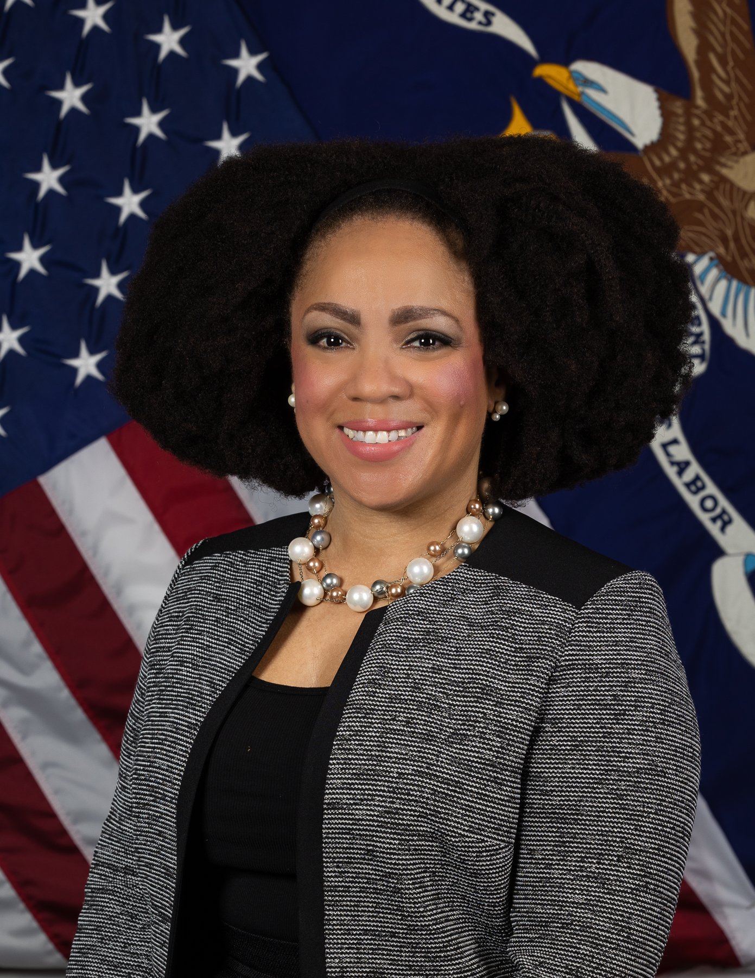
ODEP Remarks
Taryn Williams
Assistant Secretary of the U.S. Department of Labor
Office of Disability Employment Policy

Slide 38
Additional CAPE-Youth Resources (1)
Fostering Financial Empowerment for Youth and Young Adults with Disabilities
Unlocking the Potential of WIOA Title I – An Opportunity for Youth and Young Adults with Disabilities
Transition Services for Justice-Involved Youth and Young Adults with Disabilities: Rehabilitation and Recovery Practices
Guideposts for Success: States Engaging Employers through Policy

Slide 39
Additional CAPE-Youth Resources (2)
Improving Transition Services for Youth and Young Adults with Disabilities through Braided Funding
Expanding Apprenticeships as a Career Pathway for Youth and Young Adults with Disabilities
Promoting and Maintaining Career and Technical Education for Students with Disabilities
Guideposts for Success: Framework for the Future

Slide 40
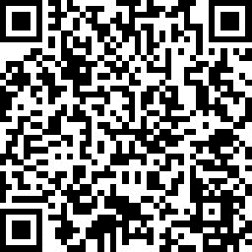
Questions? Comments?
CAPE-Youth
info@capeyouth.org
Do you have feedback for us?
Do you need
technical assistance?
40

Slide 41
Fostering Financial Empowerment for Youth and Young Adults with Disabilities Wednesday, April 24 1:00 to 2:30 pm ET
UPCOMING WEBINAR
REGISTER HERE
41

