Slide 1

Fostering Financial Empowerment for Youth and Young Adults with Disabilities

Slide 2

Housekeeping
Closed captioning is available through Zoom. Access can be found under the settings tab on your Zoom toolbar.
​
Please submit any questions (including technical issues) in the Q&A feature at the bottom of the Zoom window, and staff will get back to you as soon as possible.
2

Slide 3
Who are we?
The Center for Advancing Policy on Employment for Youth (CAPE-Youth)
3

Slide 4
The Center for Advancing Policy on Employment for Youth
The Center for Advancing Policy on Employment for Youth (CAPE-Youth) seeks to improve employment outcomes for youth and young adults with disabilities (Y&YAD) by helping states build capacity in their youth service delivery and workforce systems.
4

Slide 5




CAPE-Youth Partners
The center is fully funded by the U.S. Department of Labor’s Office of Disability Employment Policy in the amount of $7.5 million under Cooperative Agreement No. 23475OD000001-01-00.
5
Notes:
CAPE-Youth is a collaboration between the U.S. Department of Labor Office of Disability Employment Policy and:

Slide 6
CAPE-Youth Strands of Work
CAPE-Youth:
    researches new and existing innovative policy and practice;
    develops strategic partnerships;
    shares best practices among key stakeholders; and
    helps states identify opportunities for new programs and services.
6

Slide 7
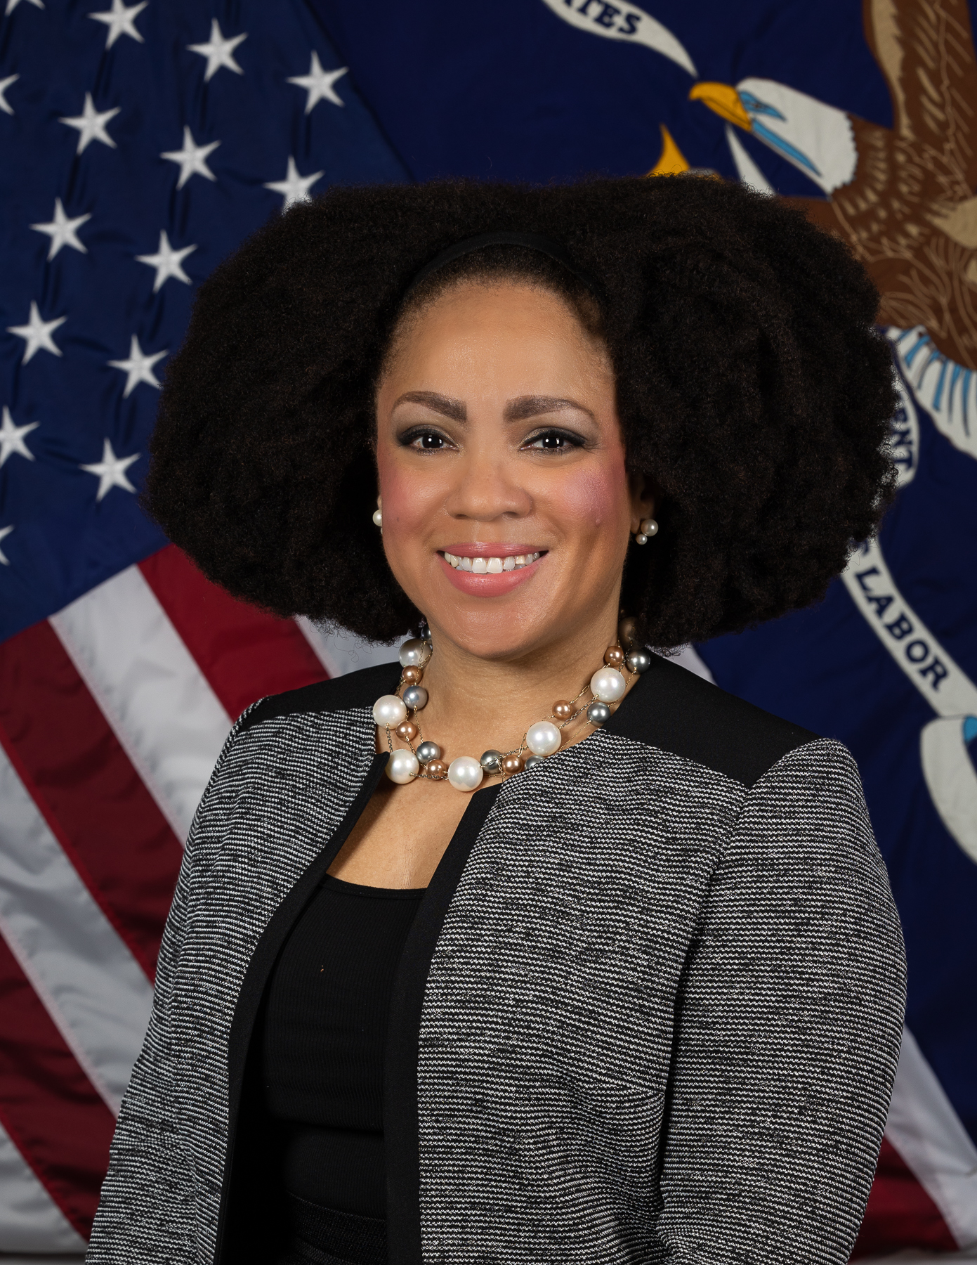
ODEP Remarks
Taryn Williams
Assistant Secretary of the U.S. Department of Labor
Office of Disability Employment Policy

Slide 8

Opening Remarks
Andrew Karhan, Ed.D.
Project Director
San Diego State University – Interwork Institute

Slide 9
Policy Considerations
Fostering Financial Empowerment
9

Slide 10
Why financial empowerment?(1)
Financial literacy is a pathway to other positive life outcomes.
  There are strong associations between financial health and physical health outcomes, meaning people living in poverty tend to have poorer health outcomes.
  Understanding the impact of working on other critical benefits and supports is essential for success.
10

Slide 11
Why financial empowerment? (2)
Y&YADs who receive supplemental security income (SSI) experience a critical decision point.
  Greater than 50% are determined ineligible for SSI at age 18.
  There are concerns about diminishing resources, with limited knowledge of budgeting, money management and asset savings strategies.
11

Slide 12
Policy Considerations (1)
1
Providing greater access to financial tools and resources.
2
Enhancing existing financial literacy education models to improve the effectiveness in reaching Y&YADs, including those with marginalized identities.

Slide 13
Policy Considerations (2)
1
3
Building upon the work of education systems in WIOA-funded programs to establish a firm foundation of financial literacy among Y&YADs and their families.
4
Leveraging the Community Reinvestment Act (CRA) to specifically address the financial empowerment of Y&YADs through public and private partnerships.

Slide 14
Providing greater access to financial tools and resources
1
14

Slide 15
Current Financial Tools
Current federal incentives and options programs:
Section 301 of the Social Security Act.
Student Earned Income Exclusion (SEIE).
Achieving a Better Life Experience (ABLE).
Individual Development Accounts.
15

Slide 16
Options for Innovation
States can incorporate game-based models to support learning:
  The Stock Market Game (i.e., a tool to engage students in improving academics, financial knowledge, and saving and investing habits)
  Chair the Fed (i.e., an online simulation developed by the Federal Reserve Bank of San Francisco).
Illinois State Treasurer’s model to increase learning and understanding of financial concepts.
16

Slide 17

Enhancing existing financial literacy education models
2
Samantha Johnston, CAST, Chief Postsecondary & Workforce Development Officer
17

Slide 18
Advancement for Equity
Many tools exist, but not all have been adapted to support people with:
  disabilities; or
  intersecting identities.
Universal design for learning (UDL).
18

Slide 19
CAST
Can you provide an overview of UDL?
Why is it essential to incorporate these principles into financial literacy materials for Y&YADs?
How might a policymaker move forward with efforts to ensure UDL is used to support Y&YADs?
19

Slide 20

Building upon models in education
3
Jill Wheeler, Consumer Financial Protection Bureau, Senior Financial Program Specialist
20

Slide 21
Policy in Action
Movement nationally to ensure students take personal finance courses before graduation.
  Seven states by 2027 (OR, LA, CT, MN, IN, and WV).
Are these universally designed and accessible?
What are the options?
21

Slide 22
Models to Build Upon
Federal Deposit Insurance Corporation’s – Money Smart Curriculum.
Specific designs for youth and young adults.
Educator guide, slides and handouts.
Optional online games and tools.
Consumer Financial Protection Bureau (CFPB).
Your Money, Your Goals.
22

Slide 23
Consumer Financial Protection Bureau (CFPB)
Can you provide an overview of the “Your Money, Your Goals”?
Why are these tools important for Y&YADs?
How might a policymaker move forward with efforts to ensure Your Money, Your Goals are more broadly used?
23

Slide 24
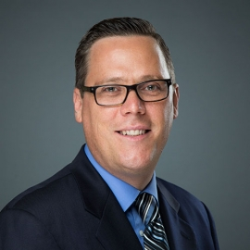
Leveraging the Community Reinvestment Act (CRA)
4
Michael Roush, National Disability Institute, Director, Center for Disability-Inclusive Community Development
24

Slide 25
The Power of CRA
The CRA was enacted in 1977 and remains a critical tool for addressing systemic credit and financial well-being inequities.
Pilots are underway with Vocational Rehabilitation (VR) and Workforce systems.
25

Slide 26
Leveraging CRA
Can you provide an overview of the CRA?
What are the opportunities you see to leverage CRA to support Y&YADs?
How might a policymaker move forward with efforts to ensure the CRA is leveraged in their state or local area?
26

Slide 27
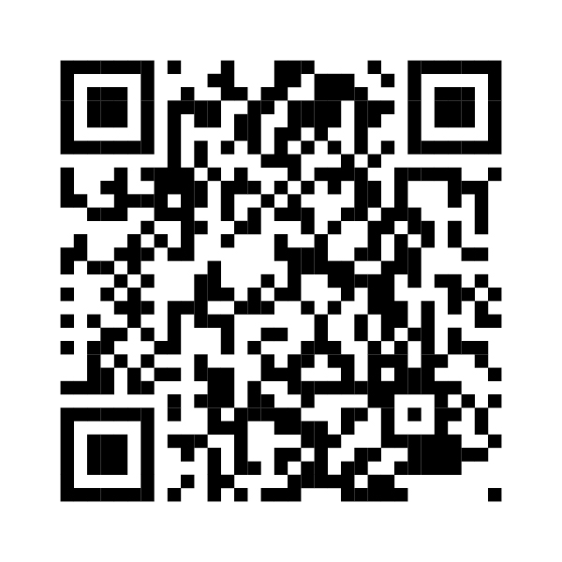
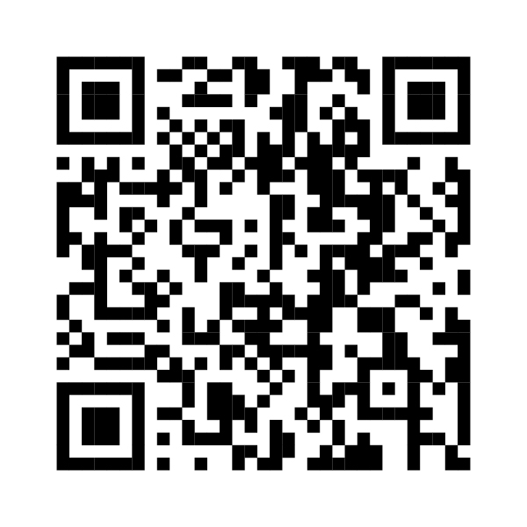

Questions? Comments?
CAPE-Youth
info@capeyouth.org
Do you have feedback for us?
Do you need
technical assistance?
27

Slide 28
CAPE-Youth Resources (1)
Unlocking the Potential of WIOA Title I – An Opportunity for Youth and Young Adults with Disabilities
Transition Services for Justice-Involved Youth and Young Adults with Disabilities: Rehabilitation and Recovery Practices
Improving Transition Services for Youth and Young Adults with Disabilities through Braided Funding
Expanding Apprenticeships as a Career Pathway for Youth and Young Adults with Disabilities

Slide 29
CAPE-Youth Resources (2)
Leveraging State Policy to Support Positive Mental Health and Employment for Youth with Marginalized Racial Identities
Improving Mental Health Service Delivery Including Coordinated Specialty Care for Youth with a First Episode of Psychosis
Trauma-Informed Policy for Youth: Structuring Policies and Programs to Support the Future of Work
Guideposts for Success: States Engaging Employers through Policy

Slide 30
CAPE-Youth Resources (3)
Addressing the Needs of Youth with Disabilities and Other Intersecting Identities: State Strategies for Program Design
Addressing the Needs of Youth with Disabilities and Other Intersecting Identities: State Strategies for Program Implementation
Guideposts for Success: Framework for the Future
Promoting and Maintaining Career and Technical Education for Students with Disabilities

Slide 31


Contact Us
Andrew Karhan, Ed.D.
akarhan@sdsu.edu
@CAPEYouth
@CSG_CAPEYouth
capeyouth.org
General CAPE-Youth Inquires
If you want to learn more about our work or participate in our research initiatives, please email info@capeyouth.org or please visit capeyouth.org.
31

